Slide 1
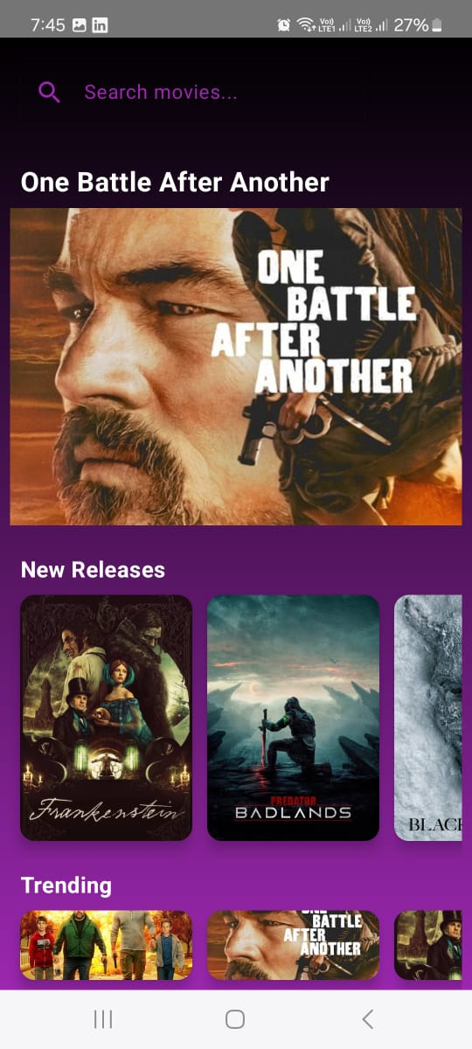


DEPI ROUND 3
Home
Product
Service
Contact
Android Mobile App
VodFlix App
movie app graduation project
depi team 3
www.depi.com

Slide 2

DEPI ROUND 3
Home
Product
Service
Contact
ABOUT US
HAGAR ZOHNY
HABIBA MAGDY
MAROCIKA AZMY
JANA AYMAN
HAGER ALAA
We are a small group of passionate Computer Science students driven by creativity and innovation. With a shared love for technology and problem‑solving, we came together to design and develop VodFlix as a graduation project in depi round 3 .

Slide 3

DEPI ROUND 3
Home
Product
Service
Contact
About Our App
Discription
VodFlix is a simple and modern movie app that helps you stay up to date with the latest trending films while giving you access to all available movies in one place. Browse detailed descriptions, explore categories, and quickly find what you’re looking for with the built‑in search feature. Entertainment made effortless, right at your fingertips.
Platforms
it’s only avalible on android phones
Show More

Slide 4
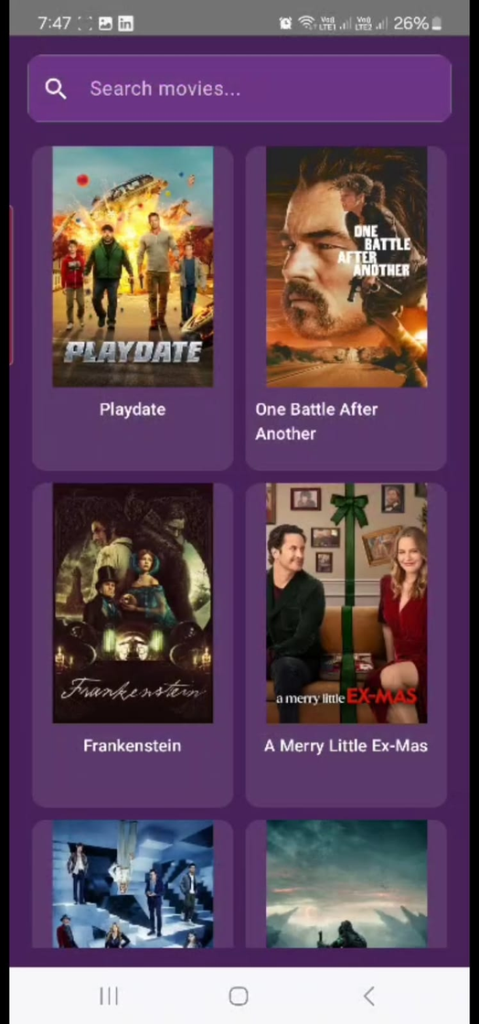
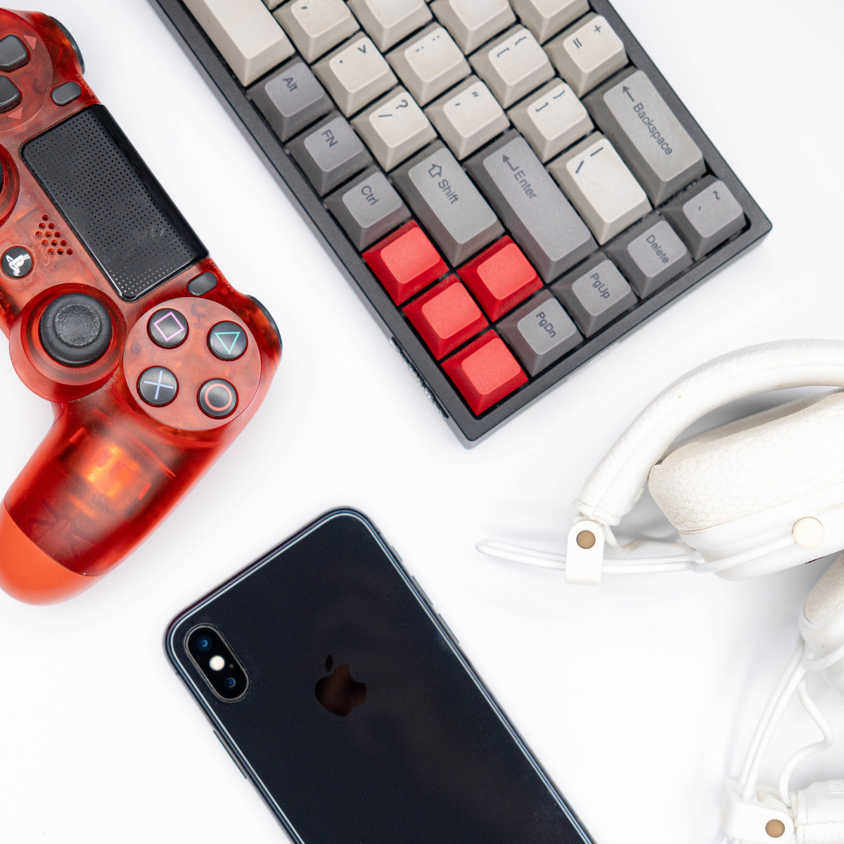
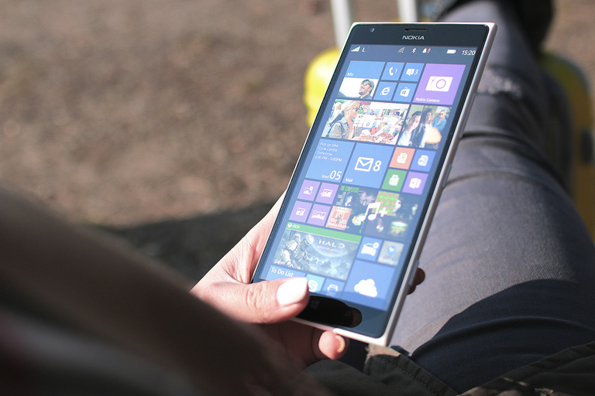

DEPI ROUND 3
Home
Product
Service
Contact
App Features
show all movies includes a trending section
search for any movie you need
show the film details (poster , story )
perfect design using jetpack compose

Slide 5




DEPI ROUND 3
Home
Product
Service
Contact
Technologies Used
VodFlix Application Development
Kotlin
Jetpack compose
Navigation Component
API integration (HTTP / JSON )

Slide 6
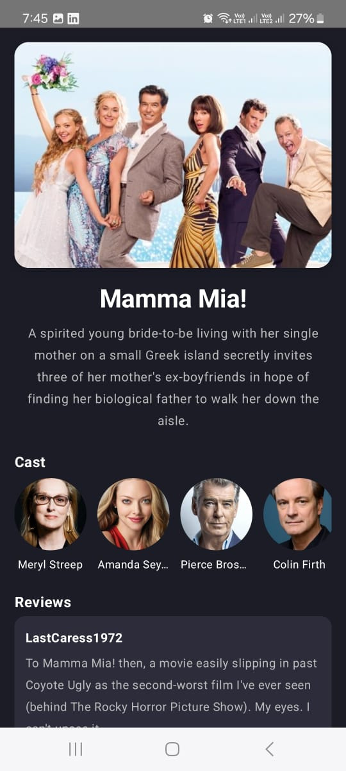
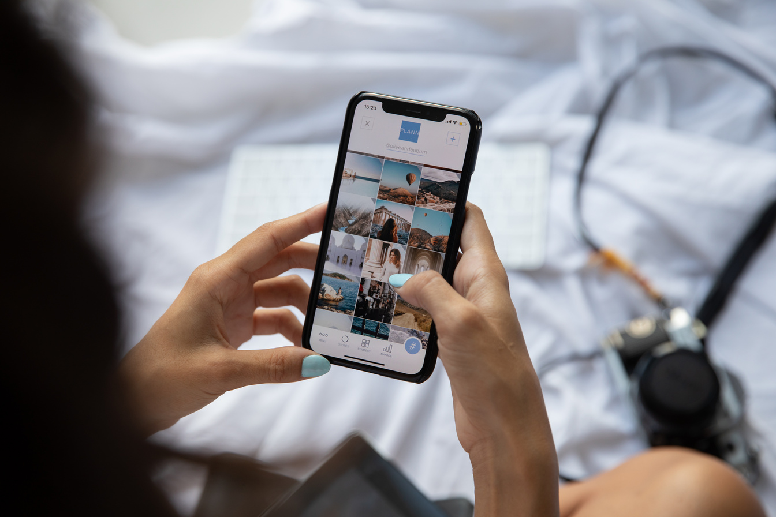
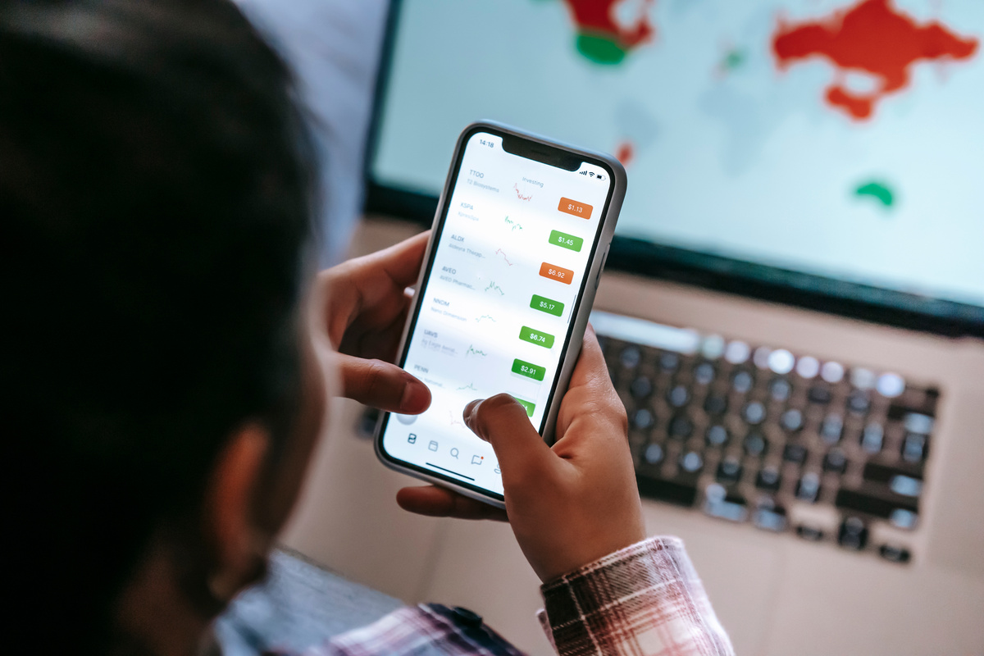

WARNER
& SPENCER
Home
Product
Service
Contact
Challenges Faced
Network on main thread exception
to fix we use Dispatchers.IO in our ViewModel
which allowed the network operations to run in the background and kept the UI smooth
Working with GitHub
it was the first time so we struggle then we learned how to make branches , commit changes , pull request
then we learned by time and know how to keep the project organised

Slide 7
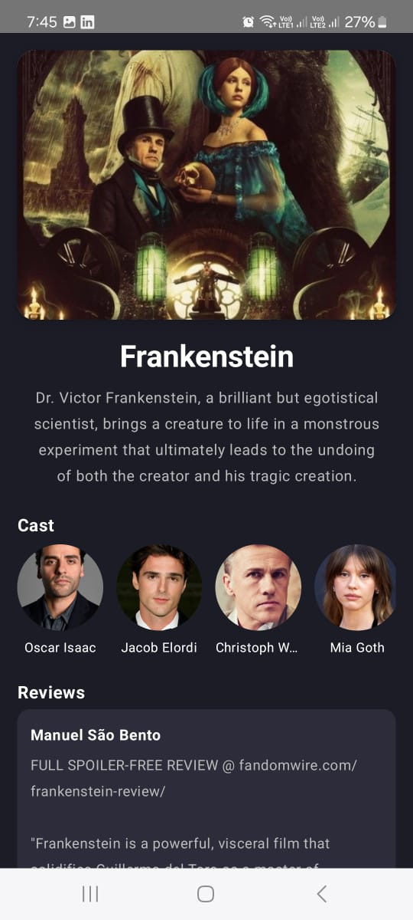
WARNER
& SPENCER
Home
Product
Service
Contact
Challenges Faced
API connection errors
to fix this we use try-catch and revise the endpoint and internet permission in the manifest
Navigation issues
to fix this we use Navigation Compose and passing movie ID as an argument to the detail screen

Slide 8
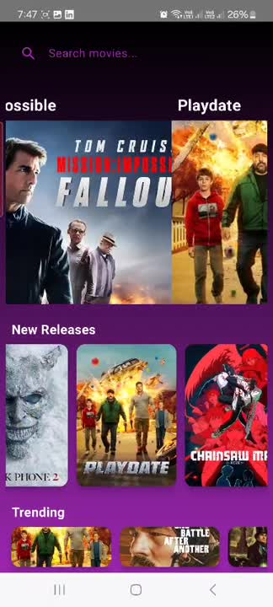

Slide 9



DEPI ROUND 3
Home
Product
Service
Contact
Mobile App Ver 3.1
www.depi.com
Thank You
Thank you for your time with us

